Slide 1

Nancy Krentz
(the owner and manager of a property appraisal service)
Nancy Krentz is manager of a property appraisal service locate in York, Pennsylvania.
She has four appraisers, but she is worried that the appraisals of comparable properties produced by her four appraisers are often not equivalent.
She wants to investigate the matter to see if her concerns are valid or not.

Slide 2

Names And Data of Appraisers
Allen | Felan | Maloy | Nelson
$34,900 | $31,839 | $34,705 | $33,669
$36,394 | $35,521 | $37,529 | $33,337
$35,863 | $35,315 | $34,875 | $33,616
$37,512 | $33,365 | $34,996 | $33,411
$36,946 | $34,990 | $37,285 | $30,504
$36,263 | $34,947 | $36,555 | $34,423
$36,041 | $34,239 | $36,704 | $34,729
$35,305 | $35,814 | $35,489 | $33,611
$34,864 | $32,896 | $37,052 | $31,870
$36,283 | $34,475 | $37,013 | $33,890

Slide 3

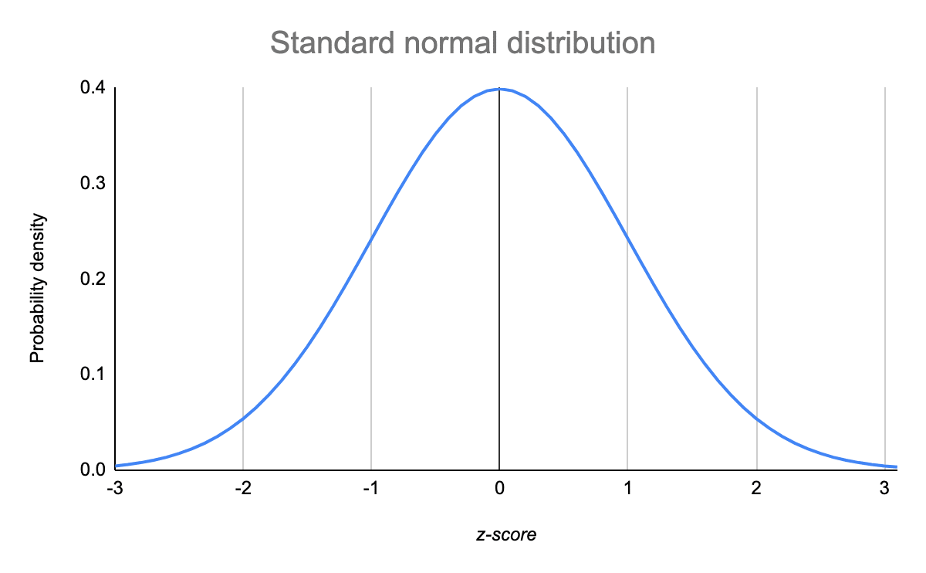
What requirements must be met to apply ANOVA ?
Normal Distribution
Equal Variance
ANOVA
Independent Sample
Random Sample

Slide 4

Is it appropriate to use ANOVA in this case?
 | Allen | Felan | Maloy | Nelson
Sample Size | 10 | 10 | 10 | 10
Standard Deviation | 848 | 1274 | 1087 | 1240
Variance | 719,528 | 1,625,355 | 1,183,560 | 1,539,983
Mean | 36037 | 34340 | 36220 | 33306
Variance
Normal Distribution

Slide 5

One way ANOVA table
Are there individual differences among the four appraisers ?
Source of Variation | Sum of Square | Degrees Of Freedom | Mean Squares | F-ratio | P-value | F crit
Between Groups | 58,674,844 | 3 | 19,558,281 | 15.4 | <0.0001 | 2.86
Within Groups | 45,615,859 | 36 | 1,267,107
Total | 104,290,704 | 39

Slide 6

which of the four appraisers are typically generating evaluations that are larger or smaller than those of the others?
 | Allen - Felan | Allen - Maloy | Allen - Nelson | Felan - Maloy | Felan - Nelson | Maloy - Nelson
Mean | 1,697 | -183 | 2731 | -1,880 | 1,034 | 2,914
p-value | 0.0025 | 0.6794 | 0.000 | 0.0023 | 0.0826 | 0.00002
Larger
Smaller
It is clear from the data above that there are significant differences between the means of the four appraisers.
The minimum absolute difference is between Allen and Maloy.

Slide 7
Has the statistical test been formulated in the best manner? In particular, was it appropriate for Nancy to divide the 40 selected properties into four subsets of ten and then assign each subset to one of the appraisers?
The test has not been formulated in the best manner as the data does not obey the assumptions of ANOVA. The data has not been divided properly and adequately.
how could the design of the study be modified to discover the most useful information in evaluating the appraisal staff at Krentz?
In order to modify the design of the study, the division of subsets from the 40 properties should also be done in random order. I think she arbitrarily divided the properties into four different subset.
Each subset should have values that are randomly allotted from the whole data rather than allotting the first 10 properties to one and so on.

Slide 8

what steps should Nancy take to improve the situation in her organization ?
There should be training programs for the weaker appraisers who are unable to obtain high appraisal amounts on the comparable land in order to obtain comparable appraisals from all appraisers.
Then she needs to retest the appraisers to find out who is the weakest based on that I explained.
More methods to enhance their ability should be introduced and looked in the matter of how they interact and convince the others.

